Slide 1

Chicago Burglary Analysis
CDT Josh Wong
CDT A.J. Pimentel

Slide 2
Introduction
Inferential Analysis
Variables Considered
Necessary Assumptions
Pimentel, Wong
Next: Problem Statement

Slide 3
Problem Statement
In this study, we aim to investigate the effect of the young males on the number of burglaries in different Chicago census blocks.
Pimentel, Wong
Next: Sources of Variation

Slide 4
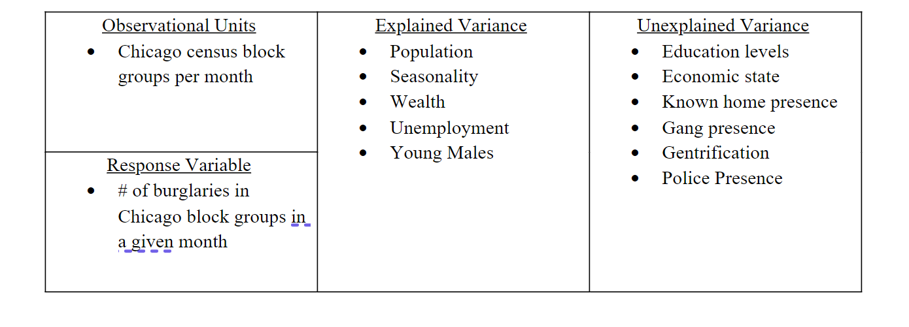
Sources of Variation
Pimentel, Wong
Next: Data Exploration

Slide 5
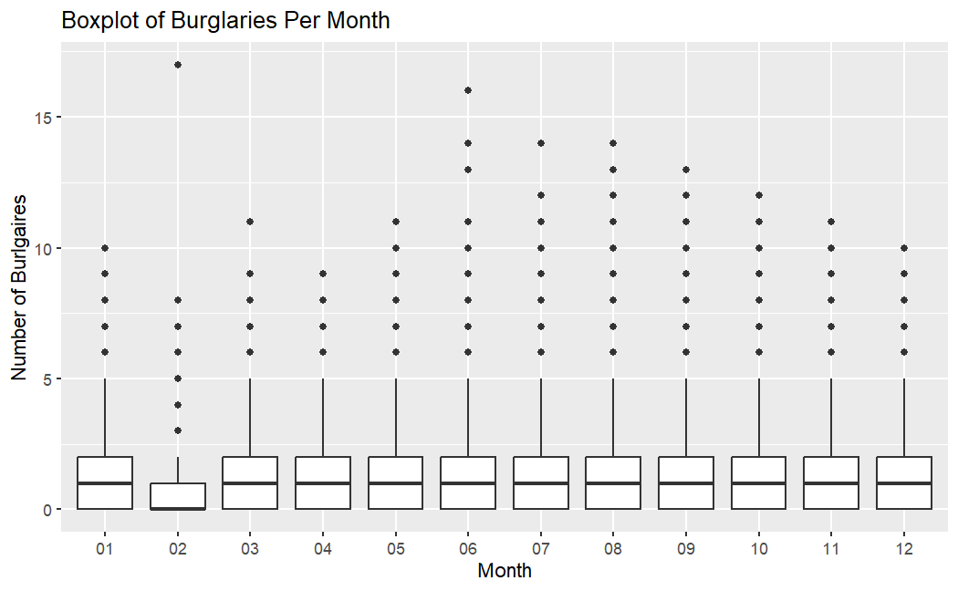
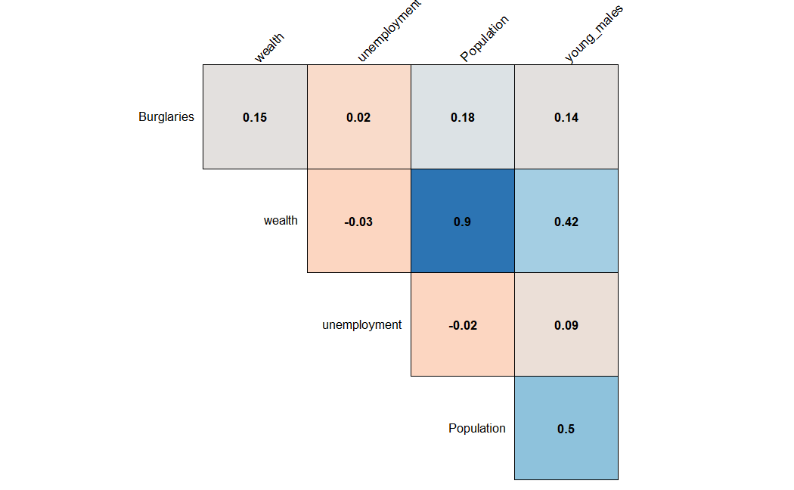
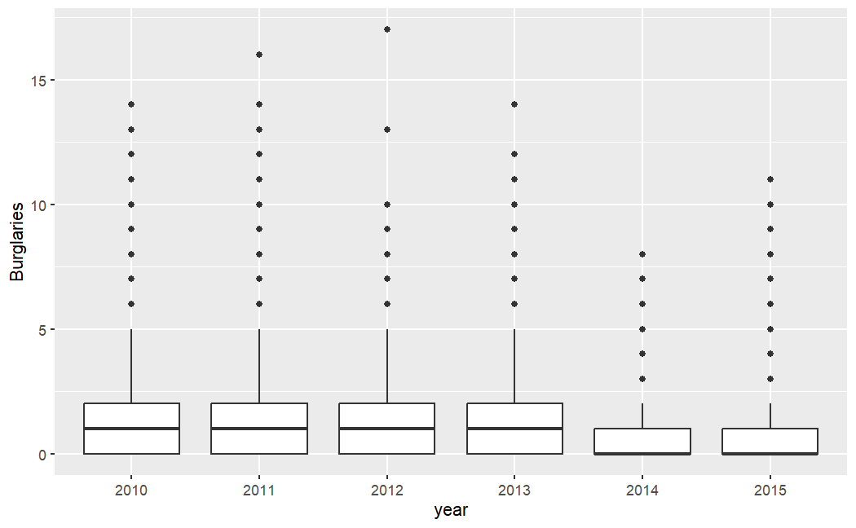
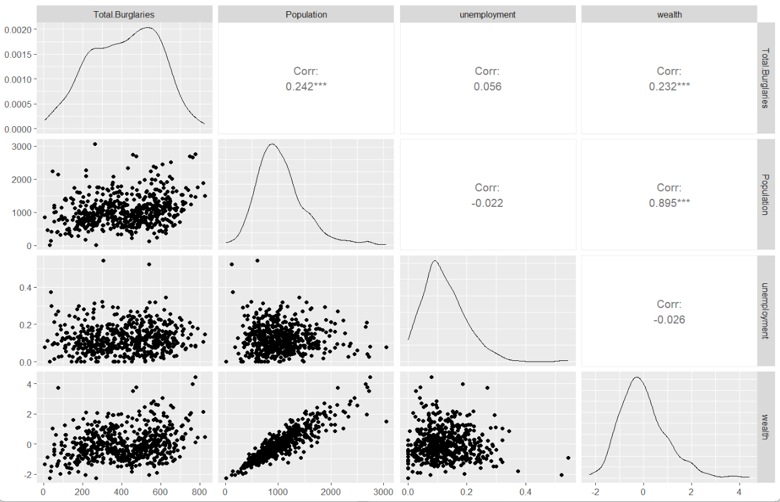
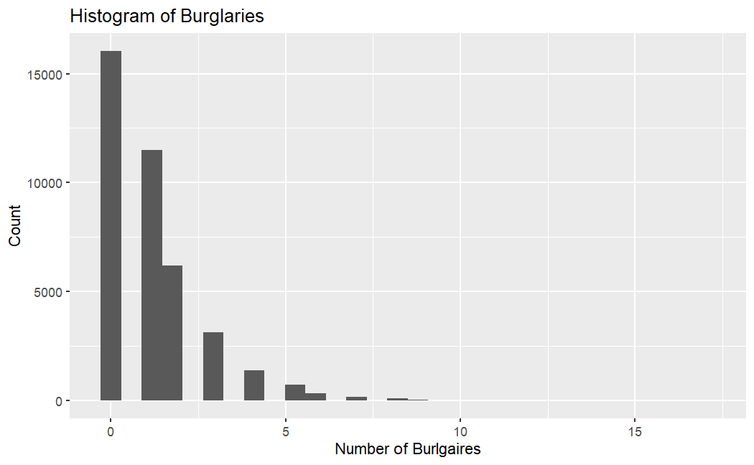
Data Exploration
Pimentel, Wong
Next: Proposed Models

Slide 6
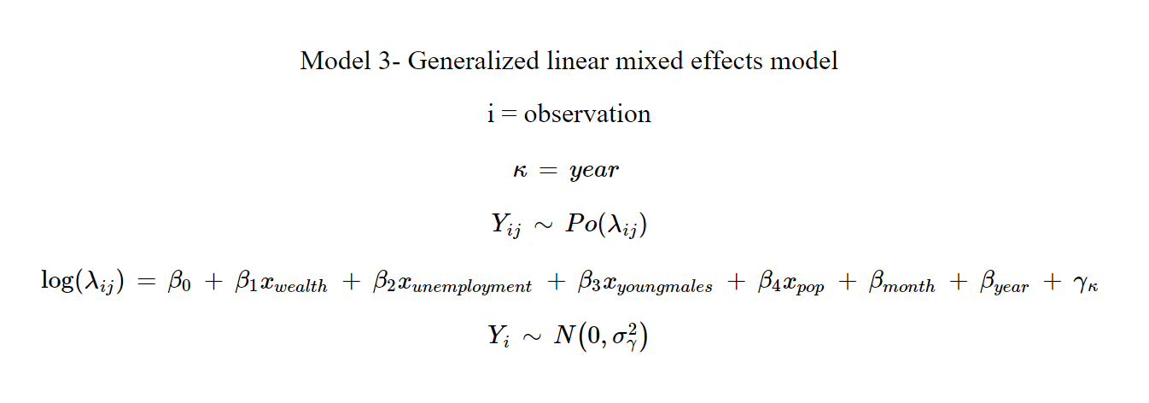
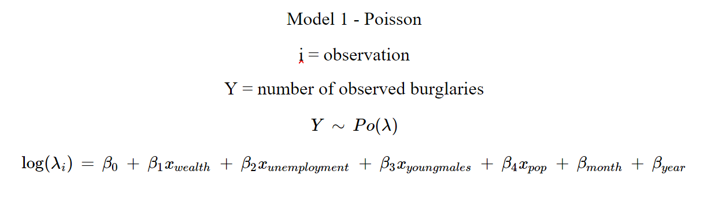
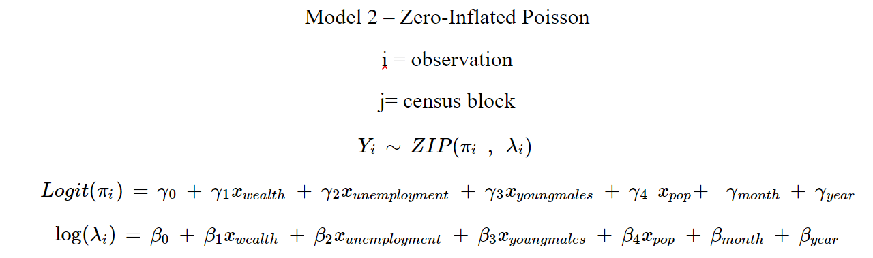
Proposed Models
Pimentel, Wong
Next: Way Ahead

Slide 7
Way Ahead
Clean data
Transform Variables
Fit Models
Compare Models
Pimentel, Wong

